Slide 1
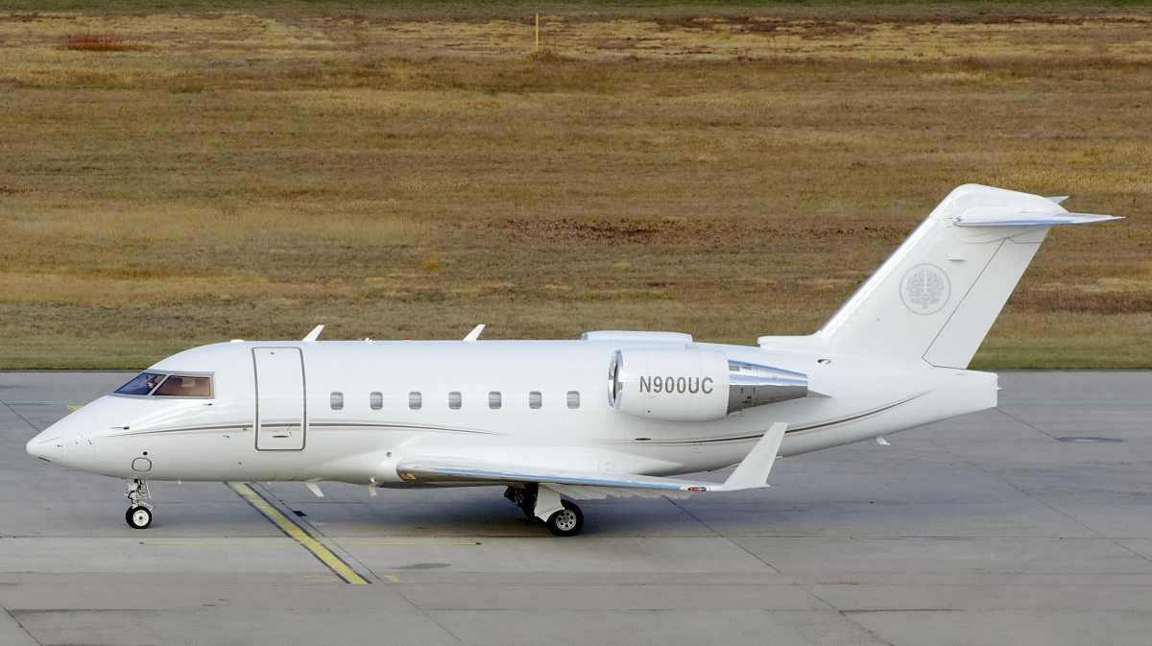



Internet
Passengers
12
2017 Gulfstream G550 | SN 5556
2002 Challenger 604 I SN 5519

Slide 2
Contact: Jeremy Stumpf Jeremy@freestream.com
2002 Challenger 604 | SN 5519 | N900UC
A I R C R A F T L I S T I N G D E T A I L S :
A I R C R A F T H I G H L I G H T S :
12 Passengers
No Damage History
Low Time
Engines enrolled on GE OnPoint
APU on MSP
ABS-B Capable
ATG 4000 GoGo Biz Wifi
* Total Hours: | 4,377
* Total Cycles: | 2,124
Engines: GE CF34-3B * Enrolled on GE OnPoint
* Total Hours: | 4,377
* Engine Cycles: | 2,124
Thrust: | 9,220 lbs
APU: GTCP-36-100
Total Hours: 3,875
Enrolled on MSP
Freestream Aircraft Limited
London
+44 207 584 3800
sales@freestream.com
Freestream Aircraft (Bermuda) Ltd
Hamilton, Bermuda
+1 441 505 1062
sales@freestreambermuda.bm
Freestream Aircraft (H.K) Limited
Hong Kong
+852 2724 5620
info@freestreamhongkong.com

Slide 3
Contact: Jeremy Stumpf Jeremy@freestream.com
2002 Challenger 604 | SN 5519 | N900UC
I N T E R I O R :
The Cabin features a fireblocked twelve (12) Passenger Configuration with a forward four (4) place executive chair double club arrangement with fold out tables. Moving aft there is a LHS four (4) place conference group with a three (3) place divan, Belted for four (4), opposite. There is a forward Galley and aft walk-in Lavatory with medium woodwork used.
The cabin interior was partially refurbished in April 2014. It included replacement of the following 3 main items:
- New Complete Floor carpet (beige color).
- New Dido side panels (light beige color).
- New Divan fabric cover (mix of blue and
beige matching colors).
E X T E R I O R :
The aircraft is painted overall Matterhorn White with coordinating accent stripes. Refurbished in 2014
Freestream Aircraft Limited
London
+44 207 584 3800
sales@freestream.com
Freestream Aircraft (Bermuda) Ltd
Hamilton, Bermuda
+1 441 505 1062
sales@freestreambermuda.bm
Freestream Aircraft (H.K) Limited
Hong Kong
+852 2724 5620
info@freestreamhongkong.com

Slide 4
Contact: Jeremy Stumpf jeremy@freestream.com
2002 Challenger 604 | SN 5519 | N900UC
A V I O N I C S :
The Challenger 604 is equipped with an integrated, Collins Pro-Line 4 avionics suite. A general summary of this aircraft’s avionics suite is as follows:
• Collins 6-Tube EFIS
• Dual Collins TWR-850 Weather Radar
• Dual Collins VHR-422B Com.
• Dual Collins VIR-432 Nav.
• Dual Collins HF-9000 HF Radio
• Dual HF SELCAL
• Dual Collins DME-442 DME
• Dual Collins ADF-462 ADF
• Collins ALT-55B Radar Altimeter
• Collins SAT906 / SATCOM direct w/Three handsets
• Additional Cabin Windows
• Securaplane 450
• ADS-B Capable
• Collins AHRS Compass
• Dual Collins FMS-6000
• Dual Collins GPS-4000 GPS
• Collins TTR-920 TCAS II w/Change 7.1
• Mark V EQPWS with Windshear warning
• Fairchild A20s CVR
• Loral F-1000 FDR
• Dual Collins TDR-94D Transponder with/Mode S
• Triple Inertial Reference System
• Rosen Cockpit Sun Visors
• Enhanced Autothrottles
Specifications subject to verification upon inspection and aircraft is subject to prior sale or withdrawal from the market
Freestream Aircraft Limited
London
+44 207 584 3800
sales@freestream.com
Freestream Aircraft (Bermuda) Ltd
Hamilton, Bermuda
+1 441 505 1062
sales@freestreambermuda.bm
Freestream Aircraft (H.K) Limited
Hong Kong
+852 2724 5620
info@freestreamhongkong.com

Slide 5
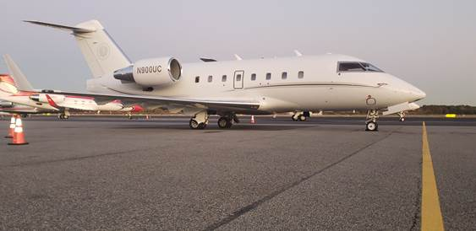
Contact: Jeremy Stumpf jeremy@freestream.com
2002 Challenger 604 | SN 5519 | N900UC
Freestream Aircraft Limited
London
+44 207 584 3800
sales@freestream.com
Freestream Aircraft (Bermuda) Ltd
Hamilton, Bermuda
+1 441 505 1062
sales@freestreambermuda.bm
Freestream Aircraft (H.K) Limited
Hong Kong
+852 2724 5620
info@freestreamhongkong.com

Slide 6
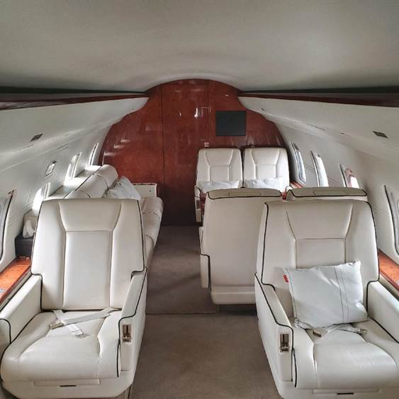
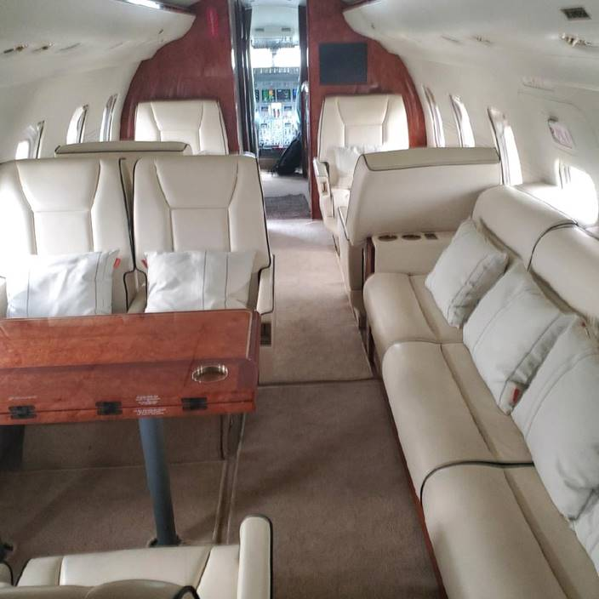
Contact: Jeremy Stumpf jeremy@freestream.com
2002 Challenger 604 | SN 5519 | N900UC
W W W . F R E E S T R E A M . C O M
Freestream Aircraft Limited
London
+44 207 584 3800
sales@freestream.com
Freestream Aircraft (Bermuda) Ltd
Hamilton, Bermuda
+1 441 505 1062
sales@freestreambermuda.bm
Freestream Aircraft (H.K) Limited
Hong Kong
+852 2724 5620
info@freestreamhongkong.com

Slide 7
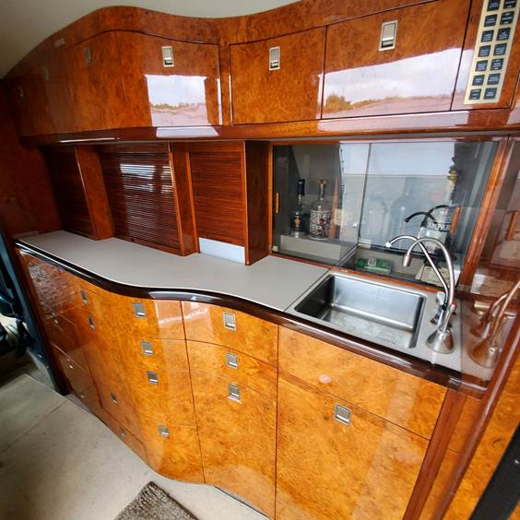
Contact: Jeremy Stumpf jeremy@freestream.com
2002 Challenger 604 | SN 5519 | N900UC
W W W . F R E E S T R E A M . C O M
Freestream Aircraft Limited
London
+44 207 584 3800
sales@freestream.com
Freestream Aircraft (Bermuda) Ltd
Hamilton, Bermuda
+1 441 505 1062
sales@freestreambermuda.bm
Freestream Aircraft (H.K) Limited
Hong Kong
+852 2724 5620
info@freestreamhongkong.com

Slide 8
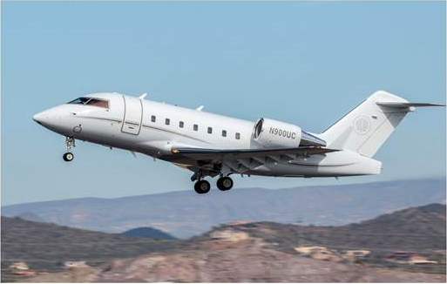
Contact: Jeremy Stumpf jeremy@freestream.com
Freestream Aircraft Limited
Freestream Aircraft Limited is proud to have a team of highly experienced and uniquely qualified aviation consultants. Our team is able to cover all aspects of aircraft brokerage, acquisition, marketing, sales, custom design services, import/export and maintenance review of your aircraft. We specialize in state of the art, medium through ultra-long range corporate jet aircraft and fully understand the importance of attending to all details as required by our clients.
Additionally, our affiliation with brokerage firms worldwide and our collateral buying power with the aircraft manufacturers, assures professional assistance to international and multinational companies as well as private individuals, artists, royalty and head-of-state clients.
Freestream’s expertise, commitment to integrity, and vast experience provide our clientele the exclusive opportunity to experience a seamless transaction in a timely manner. Principals the world over continue to find their experience with Freestream advantageous and beneficial.
Freestream Aircraft Limited
London
+44 207 584 3800
sales@freestream.com
Freestream Aircraft (Bermuda) Ltd
Hamilton, Bermuda
+1 441 505 1062
sales@freestreambermuda.bm
Freestream Aircraft (H.K) Limited
Hong Kong
+852 2724 5620
info@freestreamhongkong.com

